Slide 1




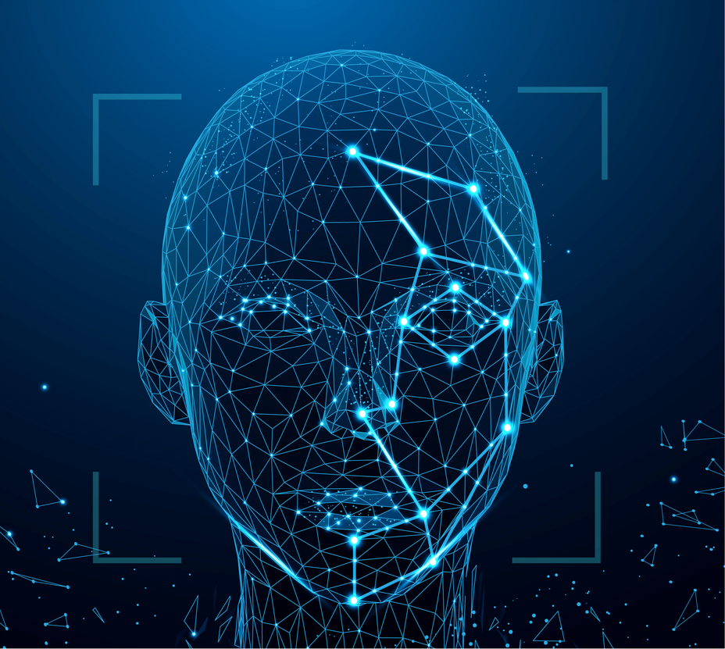
SMART ATTENDENCE SYSTEM

Slide 2



Slide 3

Generate dataset
Cascading classifier: While we are collecting open cv python our classifier is automatically installed, so we use that.

Slide 4
Path in face-classifier:
grey scale image: black and white image
0 meansgoing to the use the camera from laptop webcame.
Id=1 means id of 1st authorized person

Slide 5


l3 means ascii value of enter key-> It will go outside of loop [ESC]
CV- used for solve computer vision problems
CV2 module is used to build applications that involve image and video processing, object detection,recognition, and tracking.

Slide 6
I am using haarcascade_fronta1face_defaut. Xml to get the cordainate of
my face so that I can crop it and use it to make a dataset and forfuture prediction.
Why we use gray_scale image means RGB image has 3 channel where as grey scale image has only 1 channei. It reduces a lot of complexity if we convert to.
We use face classifier and using detect multi scale method,we get the coordinates (x,y)

Slide 7
Train the classifier and save it:
In this we use classifer.xml because our system doesn’t understand images.It needs to be converted into a Numpy array format.
So that it can make certain decisions based on this data. Classifer.xml includes certain information(data) about our faces.

Slide 8
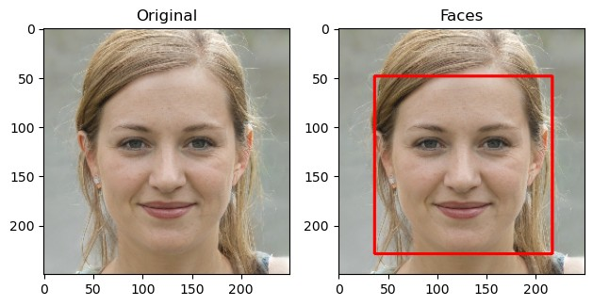

Slide 9
Detect the face and named it if it is already stored in our dataset.
Here we use draw _boundary function, which draw a boundary around the face and also display the name at the topof the face.
In this module we import image from PIL (python imaging library). Instead of PILLOW module we use PIL.
This module is used to adds support for opening,manipulating, andsaving many different image file formats

Slide 10

Haar Cascade:
That can detect objects in images, irrespective of their scale in image andlocation.This algorithm is not so complex and can runin real-time.
We can train a harr-cascade detector to detect various faces.

Slide 11
LBPH algorithm:
In this we use LBPH (Local Binary Pattern Histograms). Algorithm to detect faces.
It labels the pixels of an image by theresholding the neighborhood of each pixel and considers the results as a binary number.

Slide 12
Converting the project into GUI:
Why we convert the project into GUI means it is very important to convert any of our python projects in GUI because if we want to submit our project to our collegeor any other places it is very good to have our project in the GUI application.
It is because, we can perform every operation within the same window.

Slide 13
We don’t need to execute each cell of code again and again.
tkinter is a module used to display the window.
From tkinter we import message box.
tk.button() function is used to create the button.
tk.label() function is used to create a label.

Slide 14
window.geometry() function is used to represent the size of the window.
window.title() function is used to represent the title.
tk.Entry() function is used to create the text area to enter details.
Window.mainloop() function tells python to run the tkinter event loop.

Slide 15

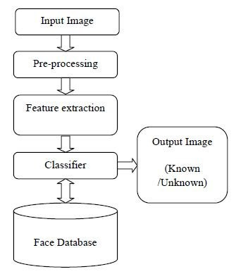


Slide 16
Connect to database:
Here we store the details of the persons by using the database.
For this we import the module MYSQL.CONNECTOR by using this we connect to database.
The name of the database is Authorized_user.

Slide 17
The table name we use in this database is my_table.
We use the cusor() function to allow python to execute sql commands in a database session.
We use Fetchall() method to retrieves all the rows in the result set of a query returns them listof tuples.

Slide 18
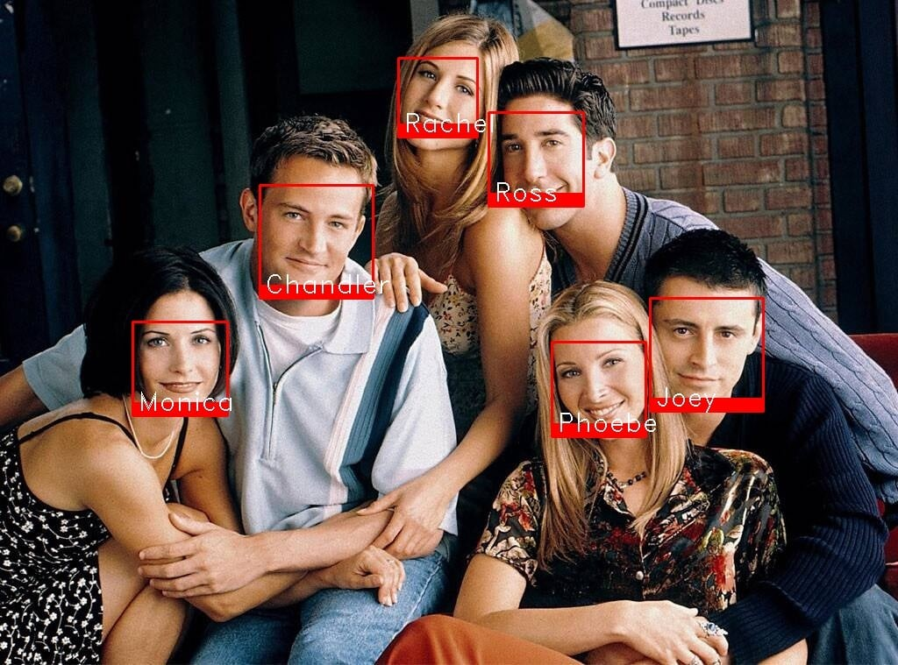

Slide 19
Convering the project into .exe file (app):
First we install pyinstaller.
Next we run the command “ pyinstaller –onefile -w GUI_Face_Recognition.py ”
By this command we convert GUI_Face_Recognition.py into .exe file (app).

Slide 20
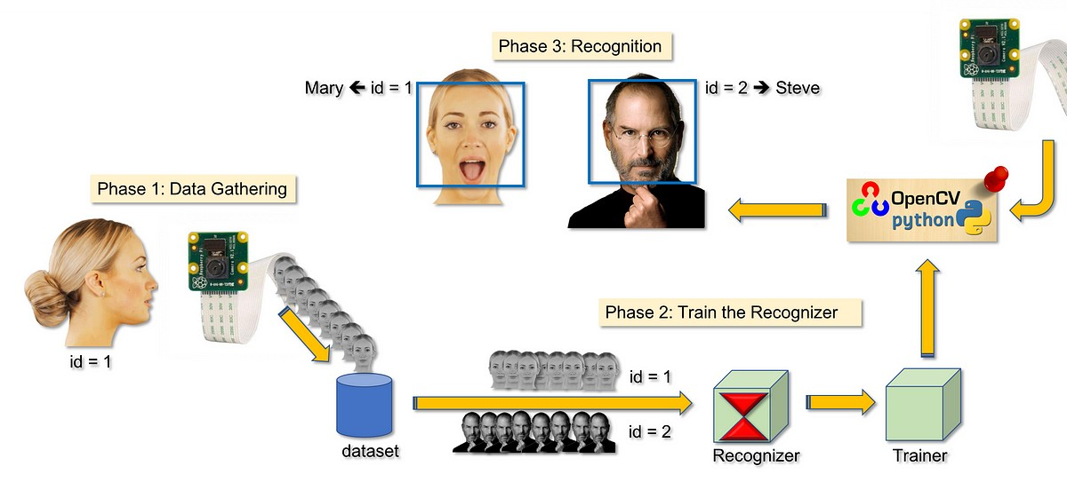

Slide 21
Conclusion
Finally we create the face recognition app which is used to generate dataset, train classifer and detect the faces. It is used to recognize the faces of the people which are trained in the dataset

Slide 22
THANK YOU

